Slide 1

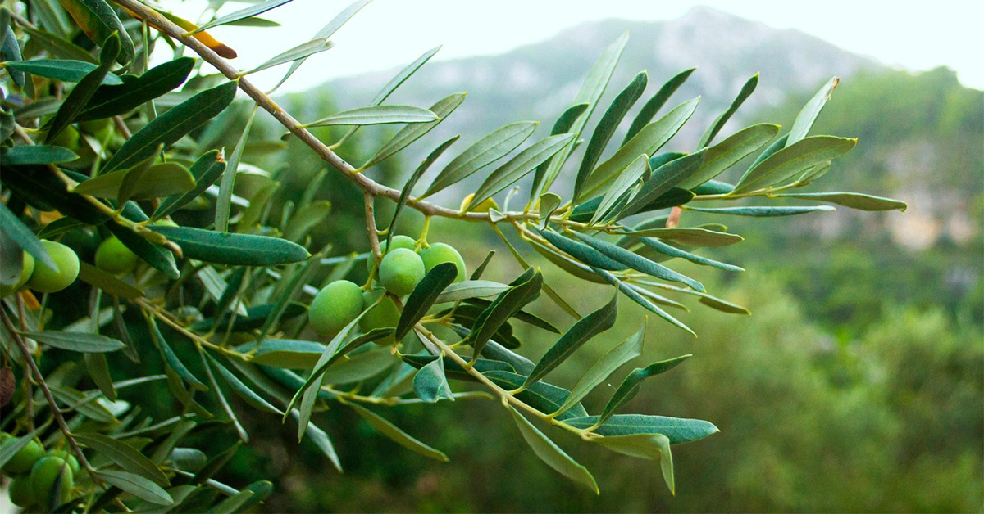







ICSAAM 2026
13th International Conference on Structural Analysis of
Advanced Materials
September 6-10, 2026 Kalamata, Greece

